Slide 1
Congressional Activity Productivity Trends
April 2024

Slide 2
Agenda
Introduction
Objectives and Scope
Measuring Productivity
Project Methodology
Data
Analysis
Findings and Conclusion

Slide 3
Introduction
The Resume of Congressional Activity has been published since 1947. It includes statistics on the number of measures introduced, bills passed, the outcome of confirmations, etc.
This project analyzes activity trends and factors that affect the productivity of Congress.

Slide 4
Objectives and Scope
Trend Analysis
Has the United States Congress become more, or less
productive over time?
Correlation
What factors influence the productivity of Congress?
Scope
98th - 117th Congresses (1983 – 2022)

Slide 5
Measuring Productivity
What makes a Congress productive?
Responsibility | Measure
Enact laws | Number of bills enacted into law
Fund the government | Number of appropriations bills passed, and timing of passage
Provide oversight | Number of confirmations

Slide 6
Project Methodology
Based on CRISP-DM Methodology
Understand Business
Define:
Objectives
Scope of work
Deliverables
Gather Background Information
Understand Data
Collect data
Load data
Preview data
Explore data
Validate Data
Verify data integrity
Address:
Duplicates
Missing data
Data errors
Outliers
Explore & Analyze
Perform analysis:
Statistical
Descriptive
Correlation
Trend
Validate & QA
Review findings
Validate:
Data
Process
Checkpoint – Are objectives met?
Visualize & Present
Finalize:
Documents
Visualizations
Presentations
Next Steps

Slide 7
Data Overview
Congressional Activity
From Senate.gov
Days, Time in Session
Confirmation Data
From Senate.gov
Nominations (civilian and military)
Political Party
Time in Congress
Measures Introduced, Measures Passed
Votes
Disposition of nominations
Demographic Data
From Brookings Institute
Positions requiring Senate confirmation
A complete list of variables is included in the Appendix

Slide 8
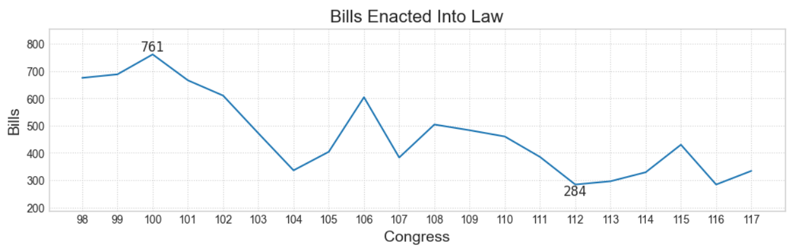
Trend Analysis – Bills Enacted
The number of bills enacted into law is generally trending downward, with a few exceptions.

Slide 9
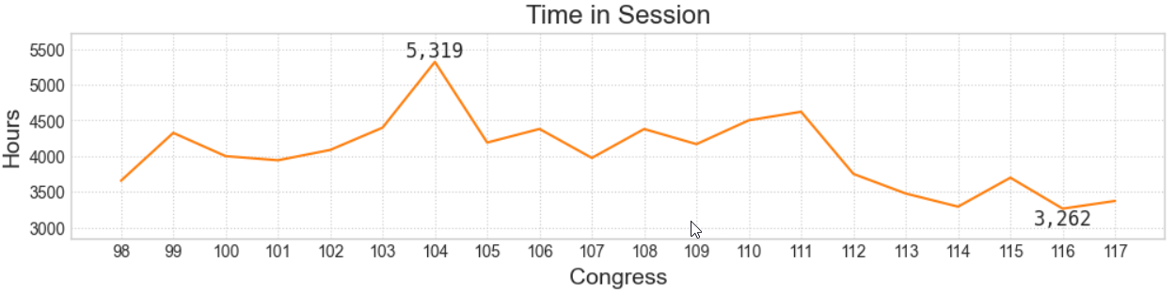
Trend Analysis – Time in Session
After the 104th Congress, the time spent in session has generally trended downward.

Slide 10
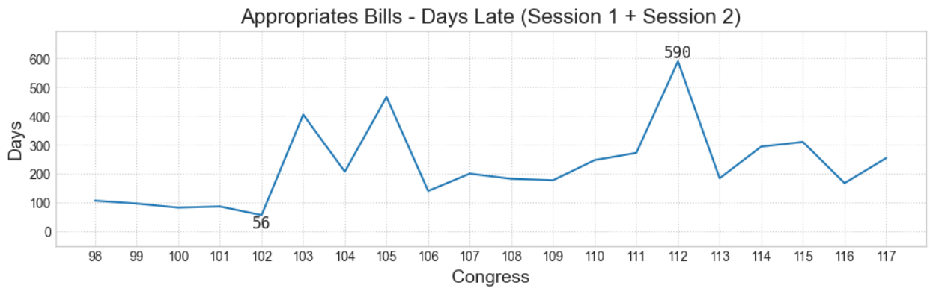
Trend Analysis - Appropriations
Congress hasn’t passed appropriations bills on time for both sessions of Congress within the range of data analyzed. There is no discernible trend.

Slide 11
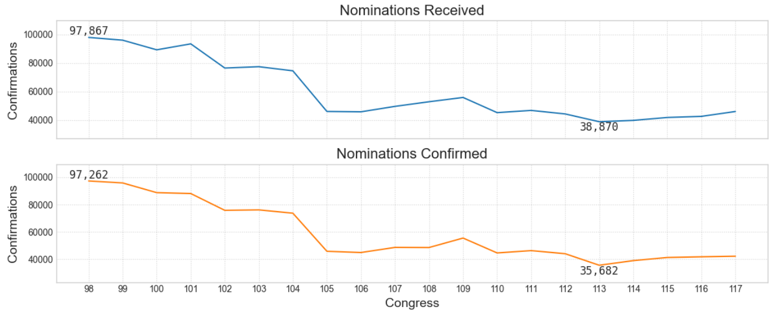
Trend Analysis - Confirmations
The number of confirmations has dropped significantly over the last 20 Congresses. However, this aligns with a decrease in nominations received from the Executive branch.

Slide 12
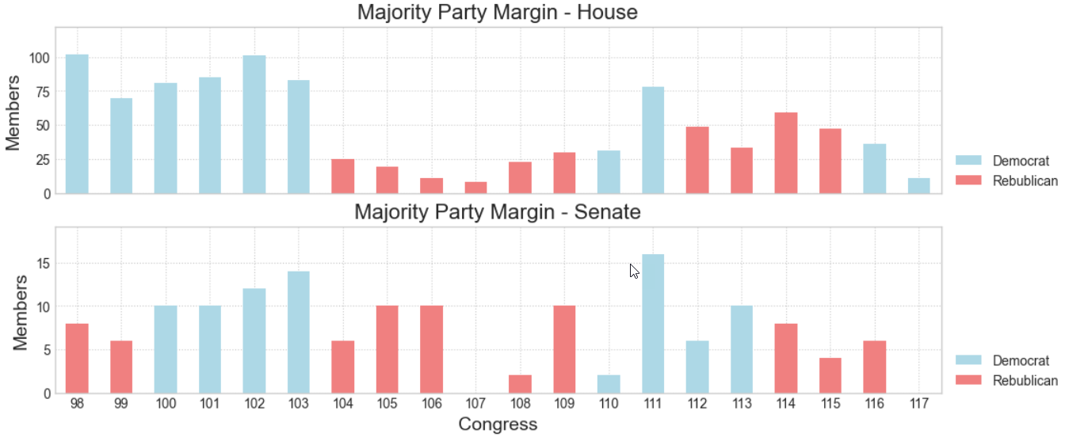
Trend Analysis – Party in Power
Control of the House and Senate has seesawed over the years.

Slide 13
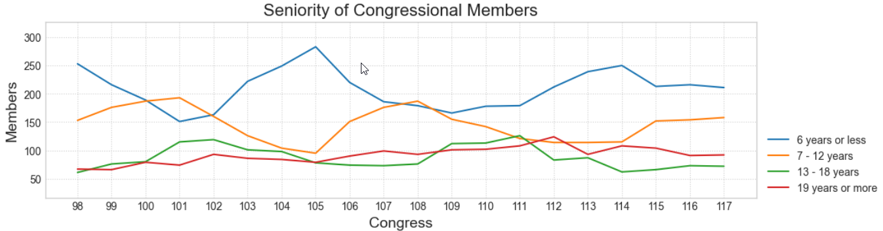
Trend Analysis – Seniority of Members
Generally, the largest portion of the membership is those with the least amount of experience in Congress.

Slide 14
Activity vs Productivity
Measures of Activity |  | Measures of Productivity
Time or days in session Measures introduced Votes held |  | Number of laws enacted
Continuing resolutions Days past Oct 1 |  | Appropriations bills
Number of nominations |  | Number of confirmations
Is there a correlation between Productivity and Activity?

Slide 15
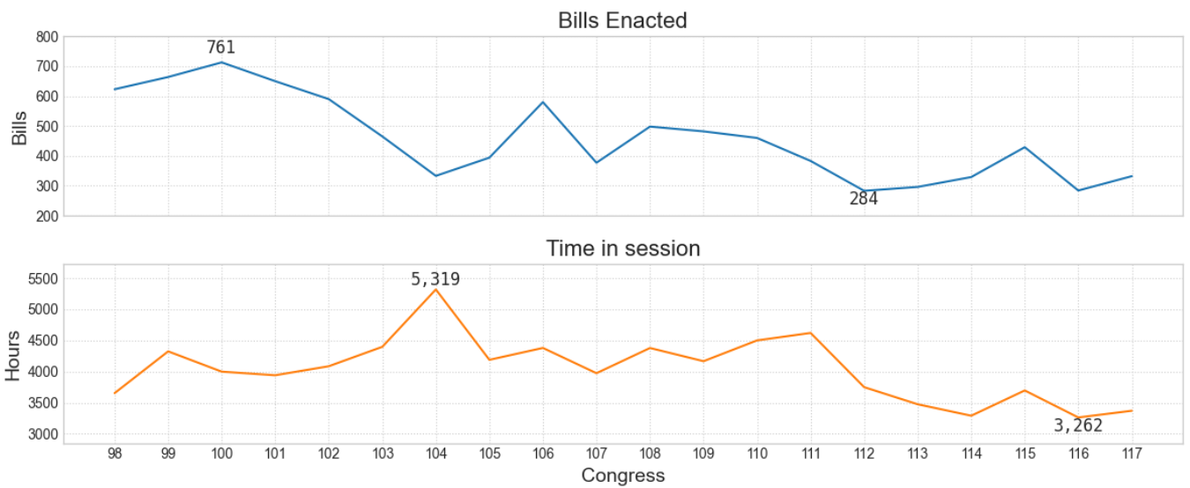
Correlation Analysis
Pearson correlation between Bills Enacted and Time in Session = 0.22

Slide 16
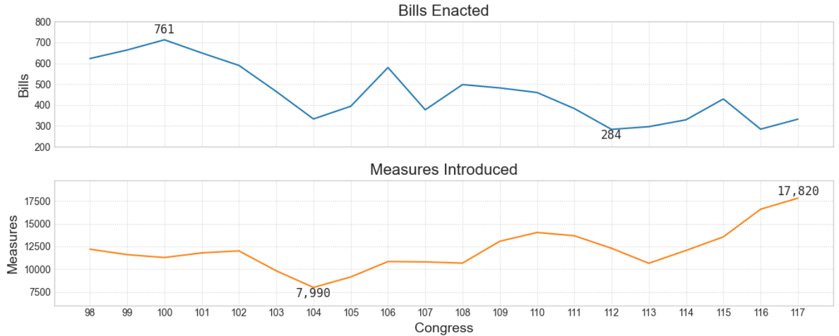
Correlation Analysis
Pearson correlation between Bills Enacted and Measures Introduced = -0.20

Slide 17
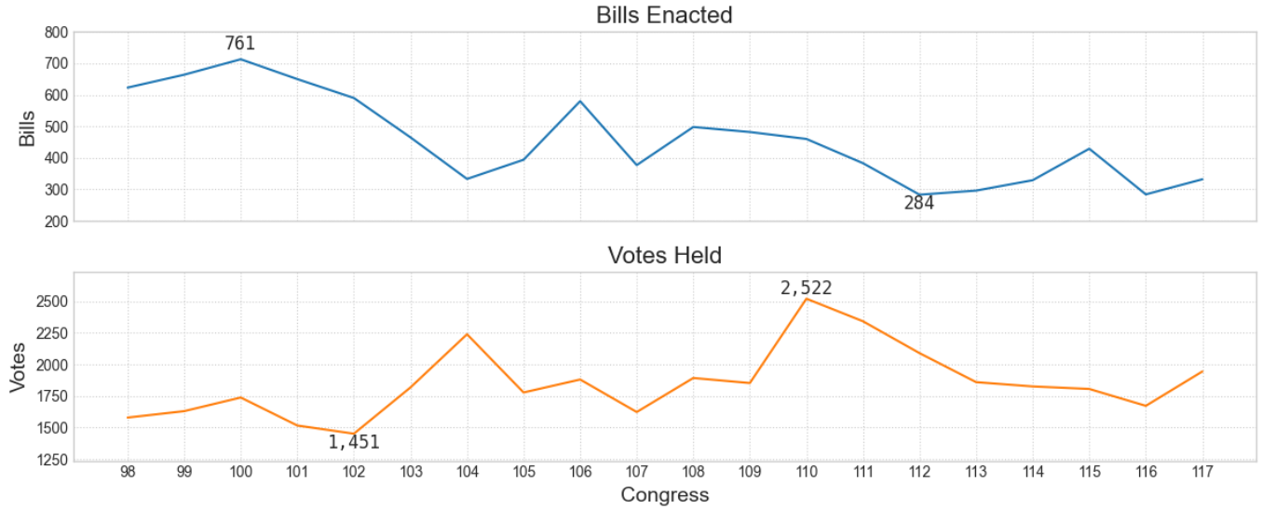
Correlation Analysis
Pearson correlation between Bills Enacted and Votes Held = -0.48

Slide 18
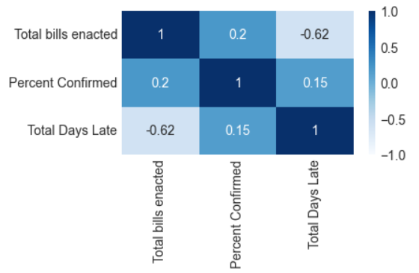
Correlation Analysis
There isn’t a strong correlation between the three measures of productivity.

Slide 19
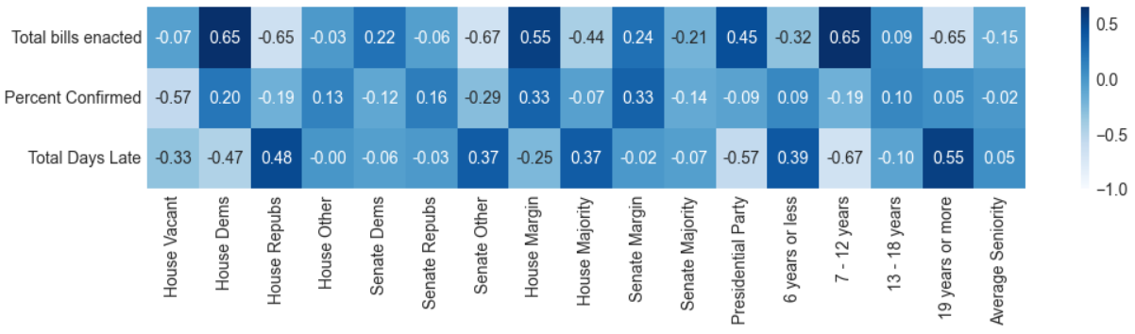
Correlation Analysis
There isn’t a strong correlation between demographics and measures of productivity.

Slide 20
Findings
There has been a general downward trend in the number of bills enacted and the time spent in session over the last twenty Congress.
The number of confirmations has decreased dramatically over the last twenty Congresses, but this is in line with a decrease in nominations from the Executive Branch. This could be interpreted as a reduction in the workload of Congress.
The appropriations process has been dysfunctional for a long time, with no Congress in the last twenty having passed appropriations bills on time during both sessions.

Slide 21
Recommendations
Data
Increase sample size to improve trend analysis
Metrics
Add of pages of legislation to assess complexity of legislation
Context
Consider historical context and significant events with regard to productivity
Add legislative hearings as another measure of productivity
Expand demographics in search of correlations

Slide 22
Thank you
Tami McManus
https://github.com/tamimcm416/congressional_activity
https://www.linkedin.com/in/tami-mcmanus/

Slide 23
Appendix A – Source Data
“Appropriations”, United States Senate, https://www.senate.gov/legislative/common/generic/bills_acts_laws_appropriations.htm. Accessed Apr 9, 2024
“Appropriations Status Table”, Congressional Research Service, https://crsreports.congress.gov/AppropriationsStatusTable. Accessed Apr 7, 2024.
“Congressional Data Scrape”, [GitHub Repository], https://github.com/tamimcm416/congressional_data_scrape, Accessed Mar 31, 2024.
“Legislation Search Results”, Library of Congress, https://www.congress.gov/search?q=%7B%22source%22%3A%22legislation%22%2C%22search%22%3A%22isRelatedToAppropriations%3AY%22%2C%22bill-status%22%3A%22law%22%7D. Accessed Apr 7, 2024.

Slide 24
Appendix A – Source Data, cont.
“List of presidents of the United States”, Wikipedia, https://en.wikipedia.org/wiki/List_of_presidents_of_the_United_States. Accessed Apr 11, 2024
“Vital Statistics on Congress.” Chapter 1, Brookings Institution, [Microsoft Excel], https://www.brookings.edu/articles/vital-statistics-on-congress/. Accessed Jan 2, 2024.

